Slide 1
Evaluating ESG Criteria in Investment Performance
Jacob Meaders

Slide 2
Objective
Investigate whether incorporating ESG criteria into investment decisions leads to better financial performance than traditional investments
Analyze how firms with low ESG risk ratings perform relative to firms with higher risk ratings
Low ESG Risk = ‘ESG’ firm
Higher ESG Risk = ‘Traditional’ firm
Provide insight to investors on whether or not ESG criteria influences actual returns

Slide 3
Background & Rationale
ESG (Environmental, Social, and Governance) criteria is new to me
Many believe ESG criteria is a ‘sham’ of sorts, so I want to analyze the validity of these firms and their returns from a strictly financial perspective
Addresses the need for investors to be informed before making investments

Slide 4
Features & Functionality
Visualizations
Data-Driven Analysis
Comparative Performance Evaluation
Statistical Tests
Regression Analysis
Practical Implications/Recommendations for Investors

Slide 5
Technologies
All coding, visualization, and modeling was done in Python
Used libraries such as:
Pandas
Numpy
Matplotlib
Scipy
Seaborn
Yfinance

Slide 6
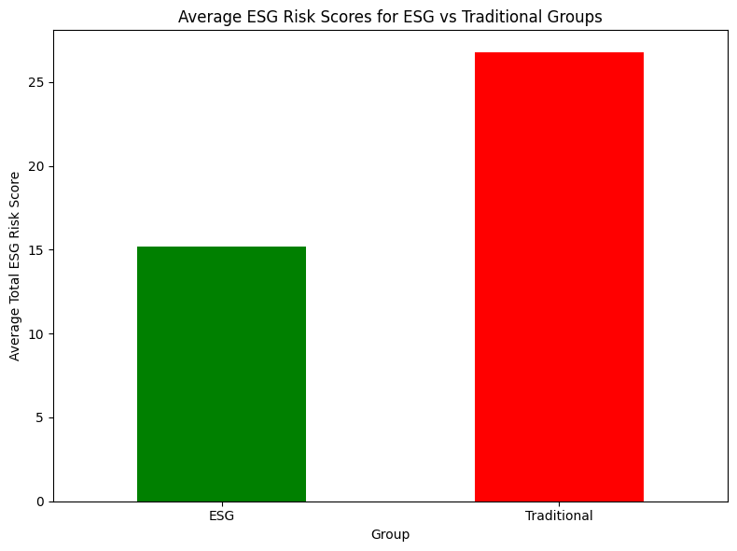
Results

Slide 7
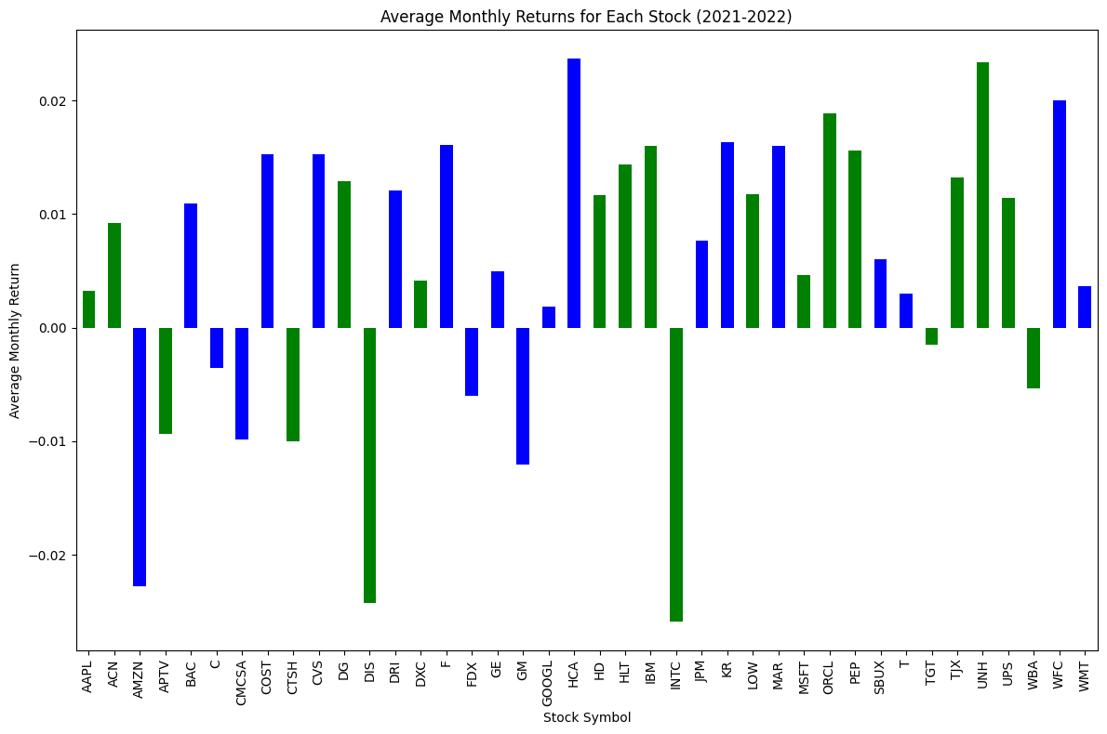
Results Continued

Slide 8
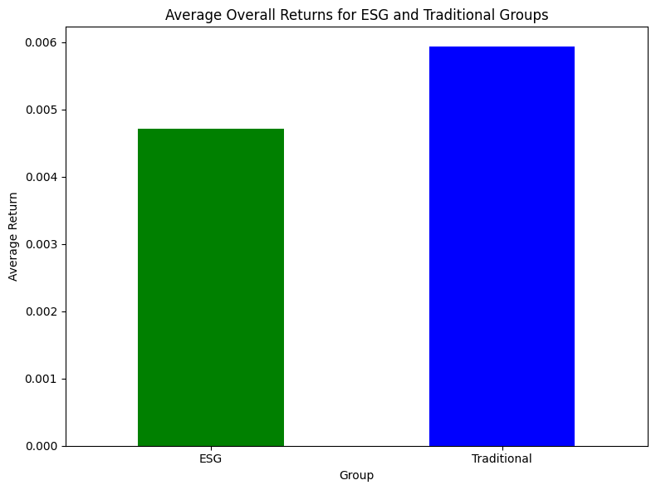
Results Continued

Slide 9


Results Continued

Slide 10
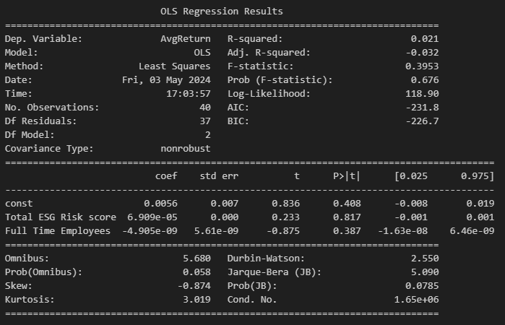
Results Continued

Slide 11
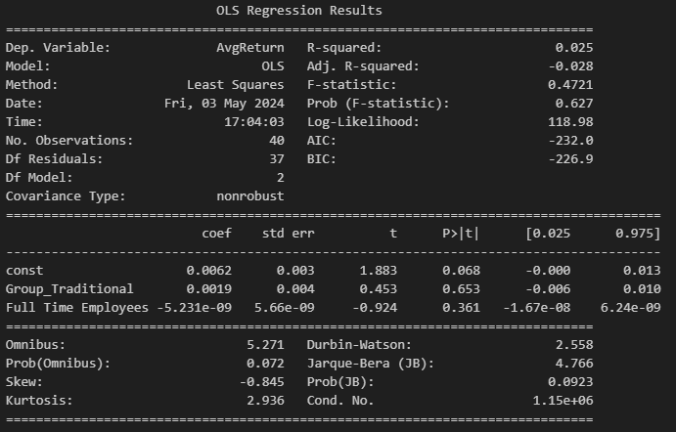
Results Continued

Slide 12
Recommendations
‘Traditional’ firms seem to have higher average returns, but by a very slim margin
Both groups (ESG & Traditional) basically performed the same
If you are splitting hairs, go with Traditional firms
If you believe the ESG firms will make the world a better place, go with those firms, as there is no significant difference

Slide 13
Future Improvement
Increase the time-period analyzed to greater than 2 years
Increase group size
For this project, only used 40 companies total
20 ESG, 20 Traditional
More advanced models
Get more granular with the groups

Slide 14
Thank You!

